Slide 1

T
CUAI Research MM 1팀
2025.09.23
발표자 : 신승현

Slide 2
팀원 소개
스터디원 1 : 김현수
스터디원 2 : 나상현
스터디원 3 : 신승현
스터디원 4: 오규안

Slide 3
Research Plan
일시, 방식) 매주 월요일 15-17시 대면 미팅
목표) JMLR submission
연구 주제)
3D Visual Grounding with LVLM

Slide 4
Research Plan: Key Limitation of 3D Visual Grounding
- Strong reliance on full supervision Heavy dependence on large-scale, manually annotated datasets.
- Foreground–background ambiguity & spatial reasoning Difficulty in distinguishing targets from clutter and reasoning about complex spatial relations.
- Lack of robustness in real-world settings Struggles with uncertain situation(multi-object, no-object, …)
- Feature space discrepancy Misalignment between visual and linguistic feature representations.
- Insufficient local reasoning Limited ability to capture fine-grained details and object-level semantics.

Slide 5
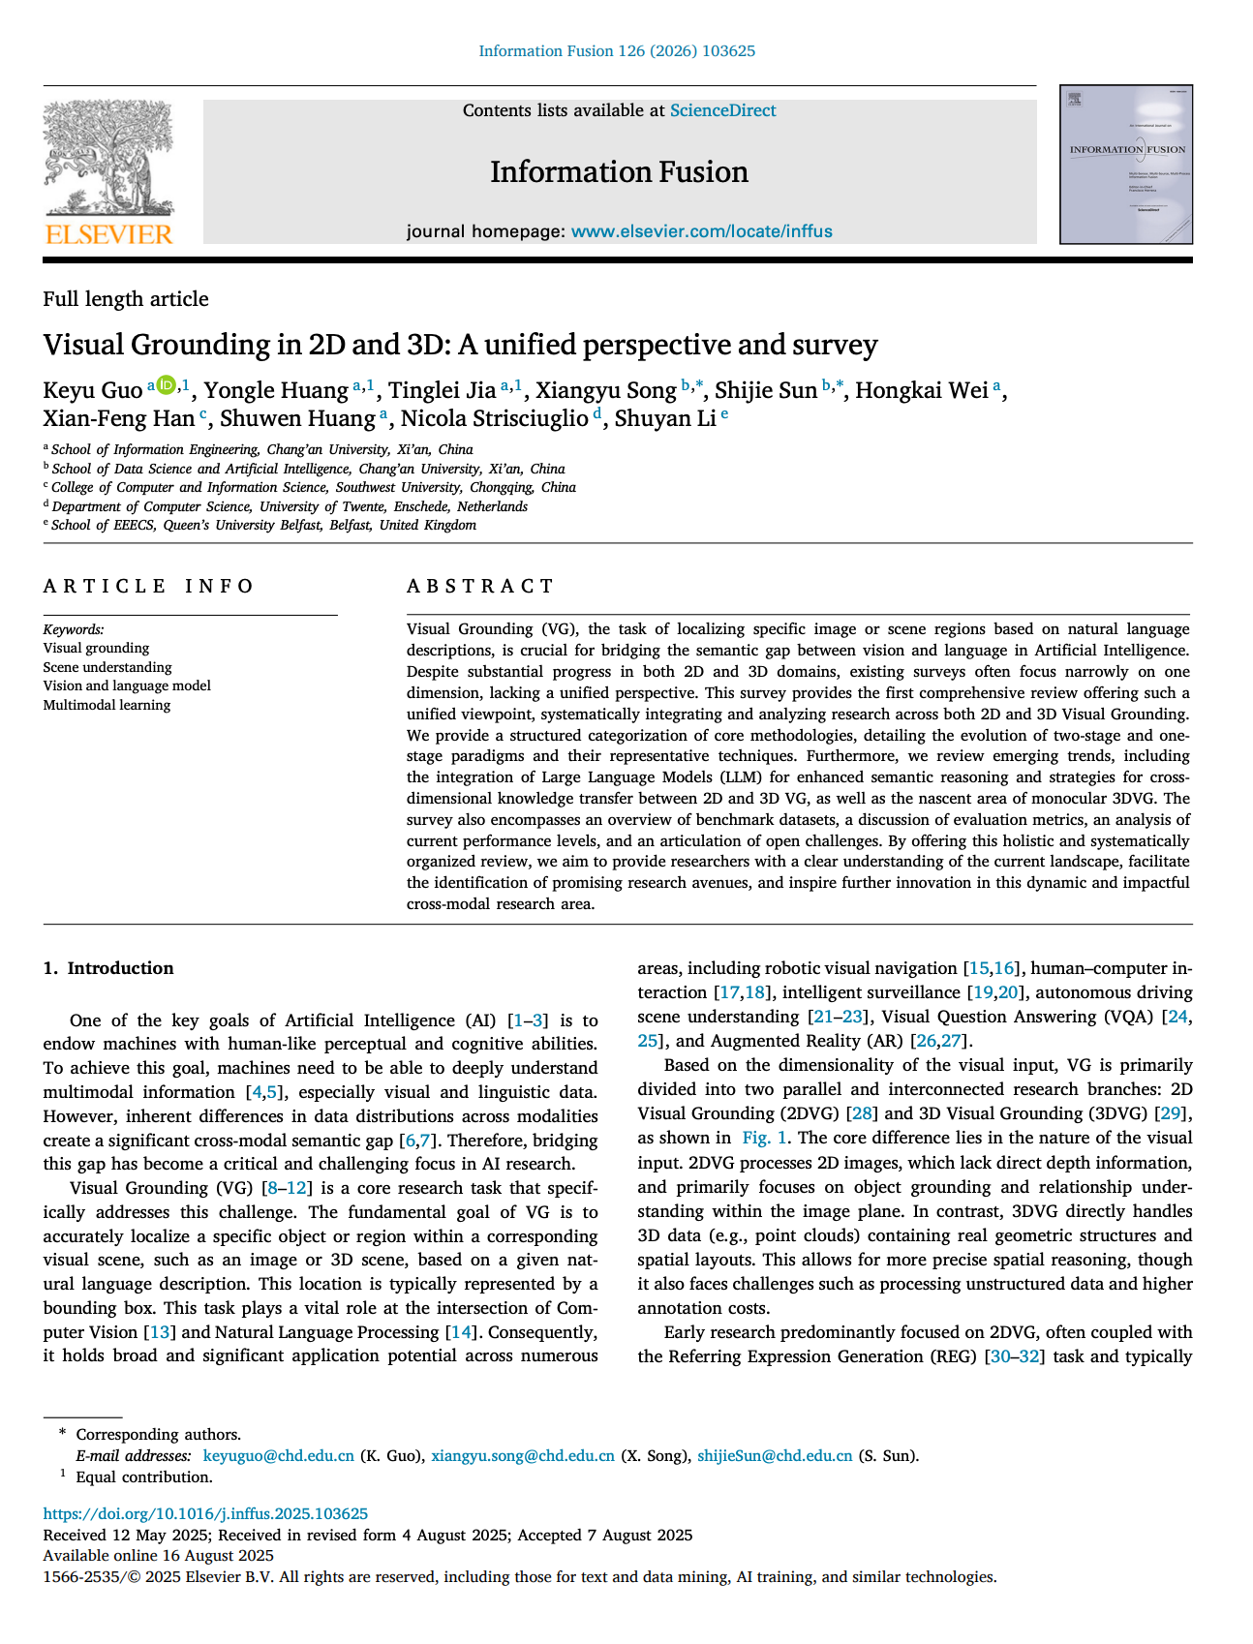
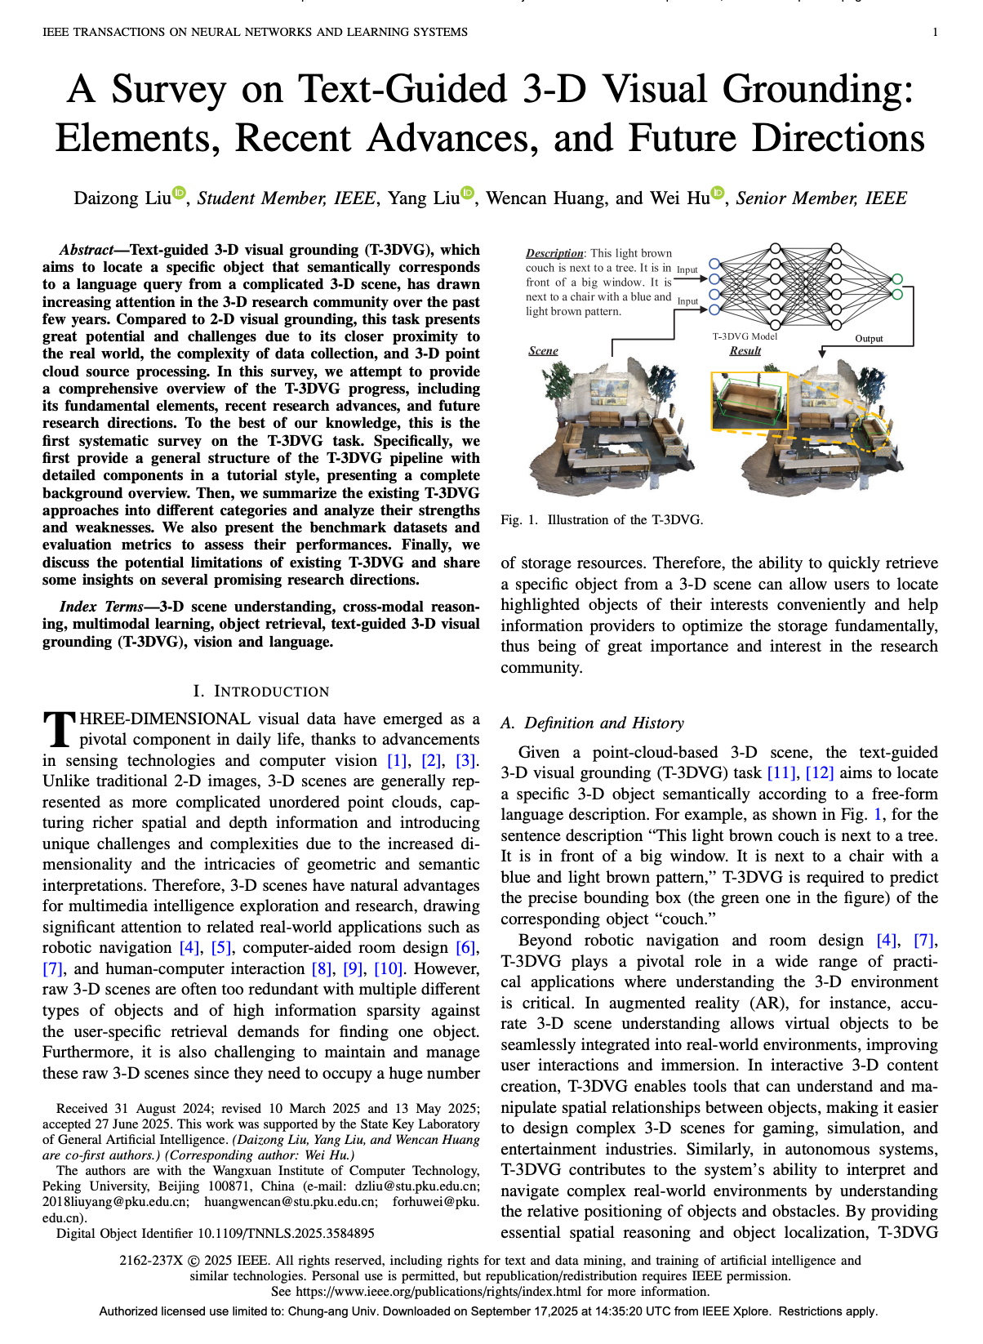
Research Plan: 3D Visual Grounding Survey 읽고 연구 주제 논의

Slide 6
감사합니다

